Slide 1


Computer Basics Lab.1
(Hardware devices you should know)

Slide 2
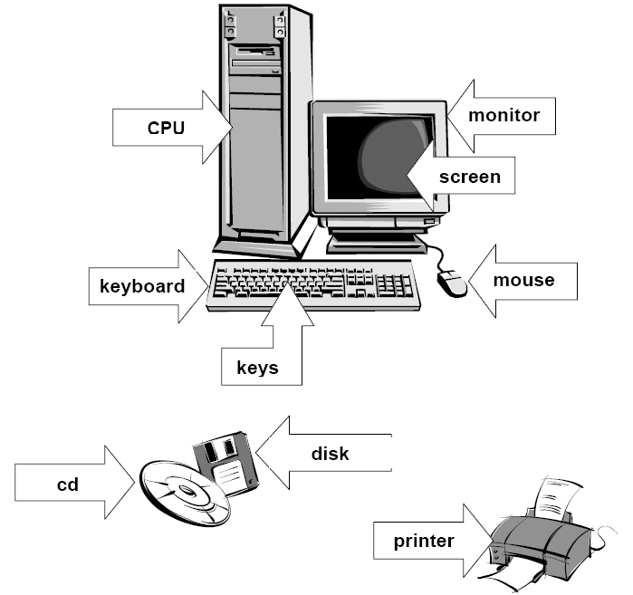

Slide 3
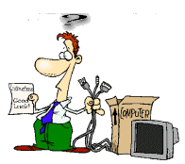
What You See
On the Front of Computer Case

Slide 4
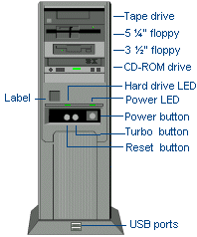
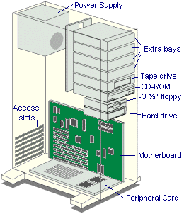
Computer Case
(in general)

Slide 5
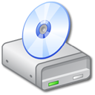






Slide 6
What You See
On the Back of Computer Case

Slide 7
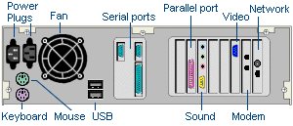
Connectors

Slide 8

Processor Fan
Uses :
to cool Power supply
To remove the heat from the processor
If you have trouble only after the computer has been on for awhile, you can put HEAT on the top of your list of suspects.

Slide 9
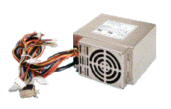
Power supply
The selected wires connected with (M.board, HD, CD drive,.. etc)
Uses: provide the computer with DC electricity

Slide 10


Connectors
Male
Female

Slide 11

Male Power cord →
Female Power cord →

Slide 12
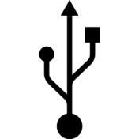
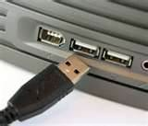
USB Connectors
Male
Female

Slide 13

Sound card Connectors
Male
Female

Slide 14
Laptop General View

Slide 19
Thanks

